Slide 1
Data 3450: Basic Stats For Machine Learning in Python

Slide 2
About me
Education:
Computer Science
Education – Secondary Math
MBA
Work:
About 12 years in corporate learning technology.
Enterprise software rollouts, LMS admin, Building of training programs.
Relevant for this: mainly building reports, analytics, ETL pipelines for data, and visualizations.
Fun:
I travel, cook, and sports.

Slide 3





More about me
I love to travel, and I love sports – mainly NBA and NFL

Slide 4
About the Course
This course covers the foundations of statistics that are relevant to machine learning.
We’ll cover these stats concepts through programming in python.
Towards the end of the semester, the stats will build into the beginnings of machine learning.

Slide 5
Logistics
Most classes will be:
A bit of new content – lecture, example, etc…
Walk through some hands-on examples.
Work through some practice examples and ask questions if there are problems.
Key content:
Textbook and workbook
In-class workbooks
You’ll need to program, likely beyond what you do in classes. The demand for this will vary between people depending on experience and background.

Slide 6
Assignments and Grading
Assignments
4 Assignments. 25% Total. Largely open-ended programming assignments.
Quizzes
3 Quizzes. 20% Total. Largely determinative programming challenges.
Exams
2 Exams. 30% Total. Largely statistics theory, some calculations.
Project
1 Project. 25% Total. Larger scale assignment, done in small teams.

Slide 7
What do I need to Get and do?
Bad news – there is a bunch of stuff needed for the course.
Good news – it is all free and most of it is also used in industry.
Worse news – getting everyone setup and ready to go can be annoying, and you’ll all probably hate me by the end of today. It does get better though!
Setup:
We’ll start getting things setup in a few minutes.
Use the link on Moodle to download “Anaconda”, it contains most of what we need to install.

Slide 8
Basics of Statistics

Slide 9

I’m here to learn cool AI Stuff, not Boring Stats. WTF?

Slide 10


Slide 11
What is Statistics?
Statistics is the language of data.
Statistics is what we use to describe, organize, analyze, and present data.
We deal (usually poorly) with stats all the time:
If you’ve taken the average of some values, you’ve done statistics.
Polling is stats.
Evaluating vaccine efficacy is stats.

Slide 12
What is Probability?
Probability is the math of predicting how likely something is to happen.
If you’ve ever gambled, you’ve used probability.

Slide 13
Statistics + Probability
Statistics and probability are like peas in the same pod!
What if we….
Collect a lot of data (statistics).
Do some analysis to look for patterns or trends in that data (statistics).
Use what we’ve learned from that data to make predictions (probability).
Moving into machine learning, we will take some datasets, and use the probability of things occurring in our data to build tools to make predictions for the future.

Slide 14

But How Does That Work?
Assume you work for Nike, you’re the boss of all of Nike. You make shoes.
For each shoe, you need to make it in a bunch of different sizes.
How many pairs do you make for each size?

Slide 15
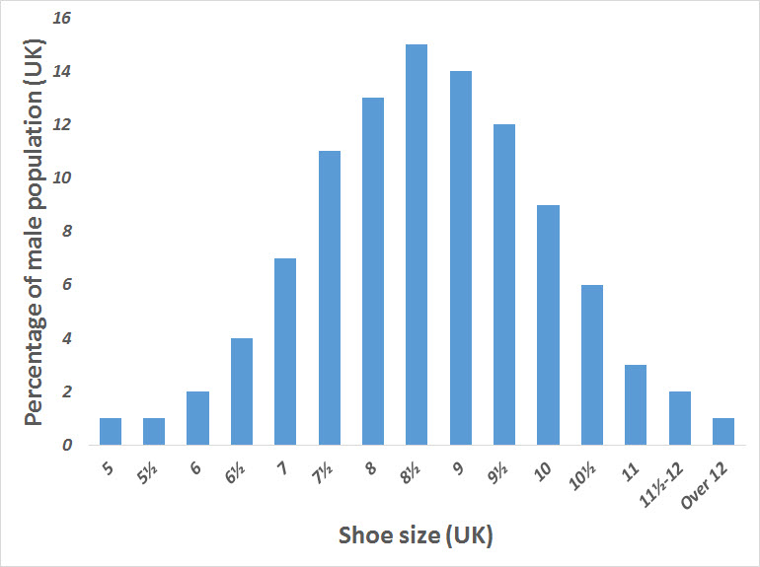
Stats and Probs to the Rescue
Collect data on shoe sizes of the population. (Statistics)
This might come from some sort of survey, medical records, or more likely, old shoe sales records.
Analyze your data to count how many people wear each size. (Statistics)
Translate those counts to likelihood – e.g. if 13% of people wore a size 9, we should expect that apx 13% of our shoes should be a 9. (Probability)
Thinking further – would basketball shoes be different from ballerina shoes?

Slide 16
Ok, Cool Bro. But I’m Still Waiting for the AI Part
That interaction is the core thing that allows analytics (data mining/machine learning/AI) to function.
When creating predictive models we do the same thing, only the computer does more of the heavy lifting:
Point the algorithm at the data.
The algorithm does some fancy math (just like our chart), and learns how to make predictions.
The outcome of this is what we call a predictive model. It takes in some data, and spits out a prediction.
We can use that model to make predictions for future situations, just like choosing shoe sizes to make.
Predictive analytics is basically just applied statistics!

Slide 17
Still Not Seeing The Need for Stats?
Understanding stats and probability helps us understand what we are doing with analytics.
Understanding of the foundations of machine learning concepts.
Diagnose errors, problems, or poor performance.
Communicate efficiently with others (stats is the language of data).
Make better and faster decisions on what data and techniques to use.
Evaluate results more comprehensively.
Make more accurate predictive models!
Knowing stats isn’t strictly necessary to do analytics, but to do it well, it is.
The more advanced you get, the more likely stats will matter.

Slide 18
In Real Life…

Slide 19
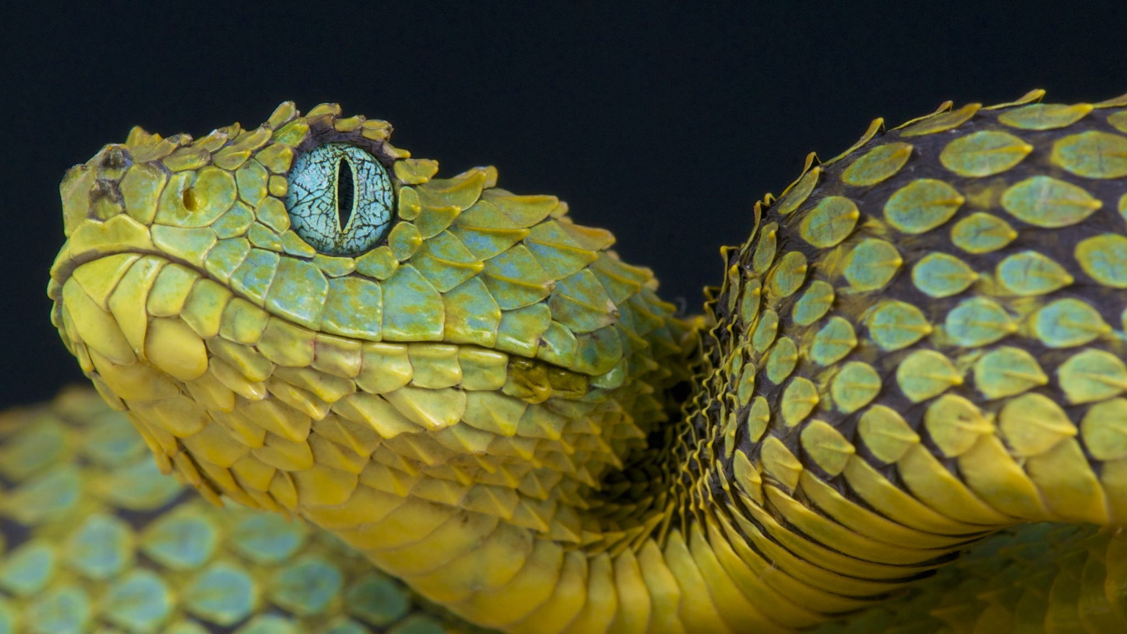
Stats in Python

Slide 20
Using Python for Stats
Python includes several packages that make it easy and quick for us to do stats stuff.
In general, we need to know what we want to do, and python will do all the actual work for us.
Little to no hands on calculating of anything.
The work we do here can flow directly into the machine learning stuff you’ll do later on.

Slide 21
Data in Python
Stats is all about data, so we first need to get data into Python.
In programming, data is stored in something called a data structure.
Data structures are ‘containers’ for data.
Each data structure facilitates different ways to store, access, and manipulate data.
Different structures are good for different things.
Python has lots of data structures, and they can get confusing.
Make sure you pay attention to this part in the programming course!!!

Slide 22
Basics
In statistics, the Population is every instance of that item.
E.g. All people who attend NAIT.
A sample is a subset of the population.
E.g. People who responded to a school wide survey.
We usually have a sample of data.
Think: how does what is in the sample impact our calculations?

Slide 23
More Basics
A survey was conducted on students in an introductory statistics course. Below are a few of the questions on the survey, and the corresponding variables the data from the responses were stored in:
gender: What is your gender?
intro_extra: What is your gender?
sleep: How many hours do you sleep at night, on average?
bedtime: What time do you usually go to bed?
countries: How many countries have you visited?
dread: On a scale of 1-5, how much do you dread being here?

Slide 24
Data Format
We generally deal with 2D tables of data, often called a datasheet.
Each row is an example, or instance, of a thing.
Each column is an attribute, or variable, describing that thing.

Slide 25
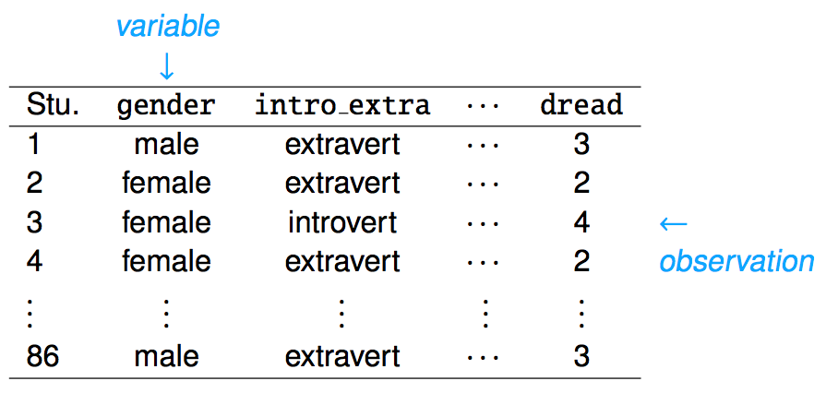

Slide 26
Values In a Dataset
Each of these values is a certain type of value.
Some values are descriptors, like name or hair color.
Some values are measurements, like height or bank account balance.
We can break datatypes into a few divisions…

Slide 27
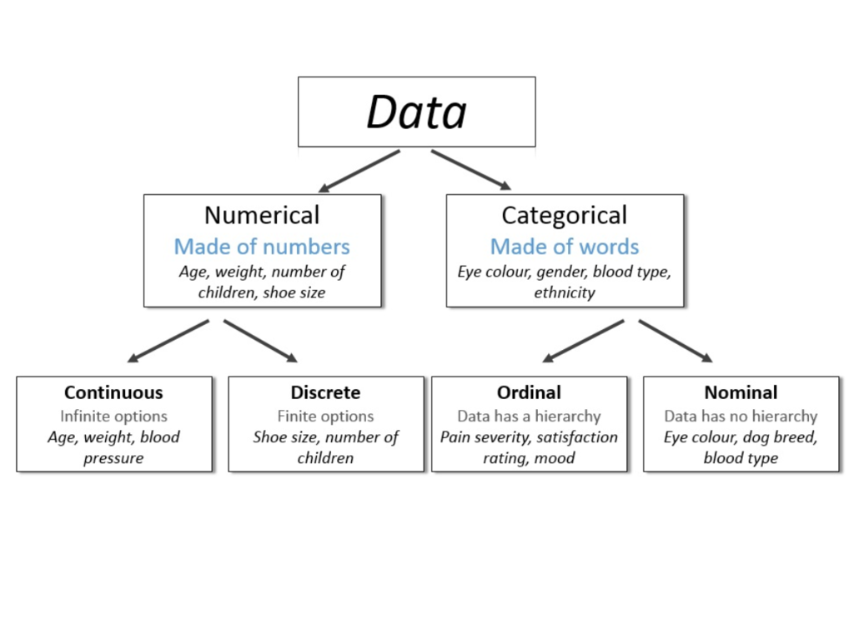

Slide 28
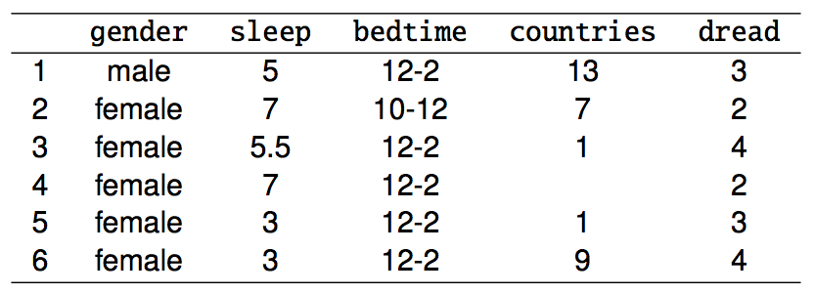
Variable Types
gender: categorical
sleep: numerical, continuous
bedtime: categorical, ordinal
countries: numerical, discrete
dread: categorical, ordinal - could also be used as numerical

Slide 29
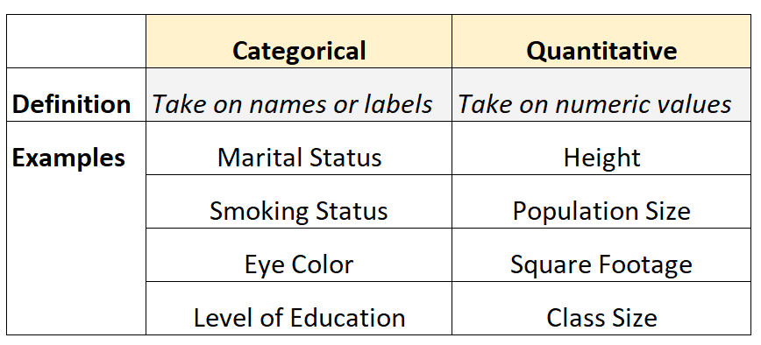

Slide 30
Data Types
The split between numerical and categorical is critical.
Predicting categorical vs numerical values when we get to ML is different.
How we analyze and process categorical vs numerical values is different.
We generally group things by categorical variables.
E.g. group all students who took IB courses in HS when looking at earnings.
We generally calculate things for numerical variables.
E.g. calculate the median of income for the IB group, compared to others.

Slide 31
Data Types
Think about how you would describe different types of data.
E.g. if you explained how much people sleep or what the gender distribution is based on the survey data…
There’s different metrics and ways to deal with different data.

Slide 32

Ok, Time to Program…

